Slide 1

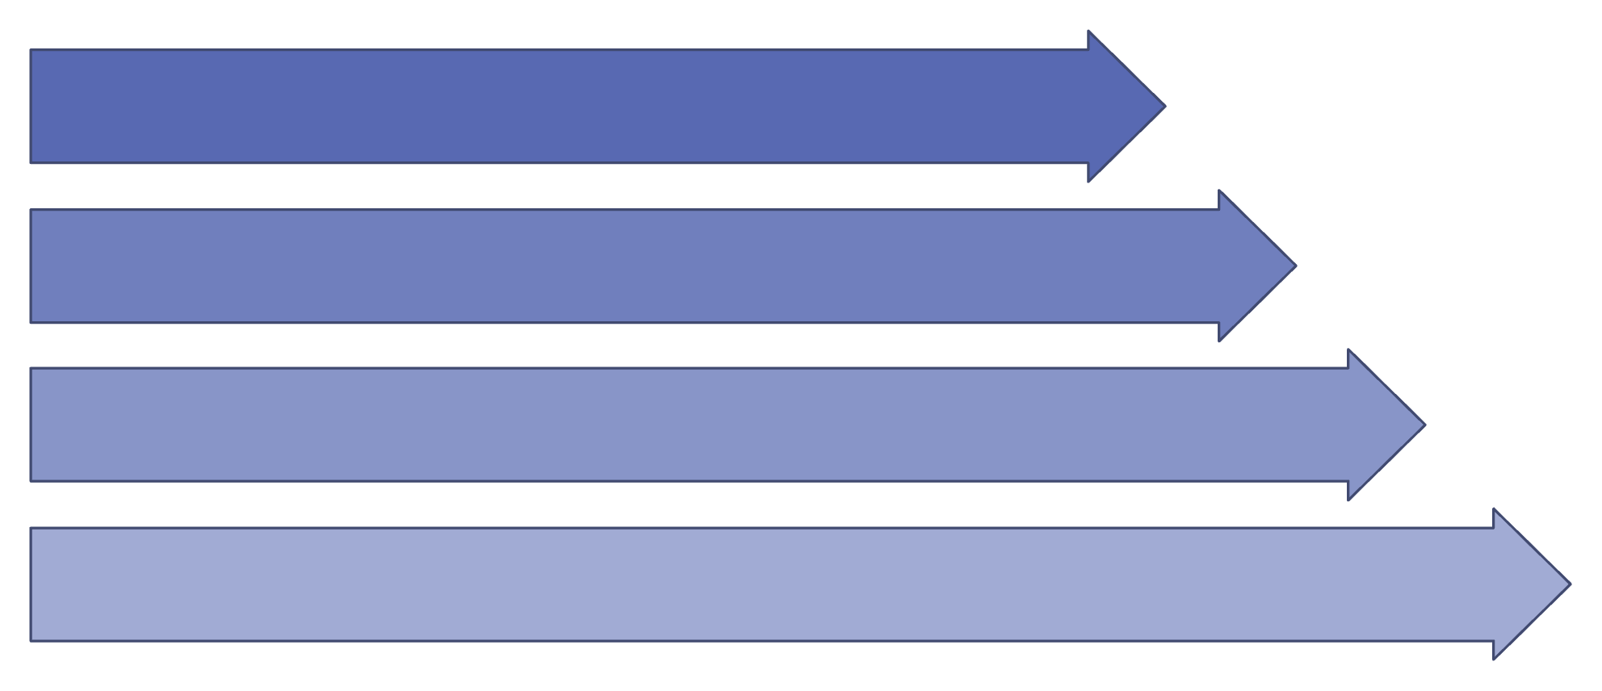
Project - Overview
An end-to-end automated analytics system integrating SQL, Python, and Power BI.
SQL Extract
Python Transform
SQL Aggregate
Power BI Visuals
Turning raw loan data into real-time risk intelligence.

Slide 2
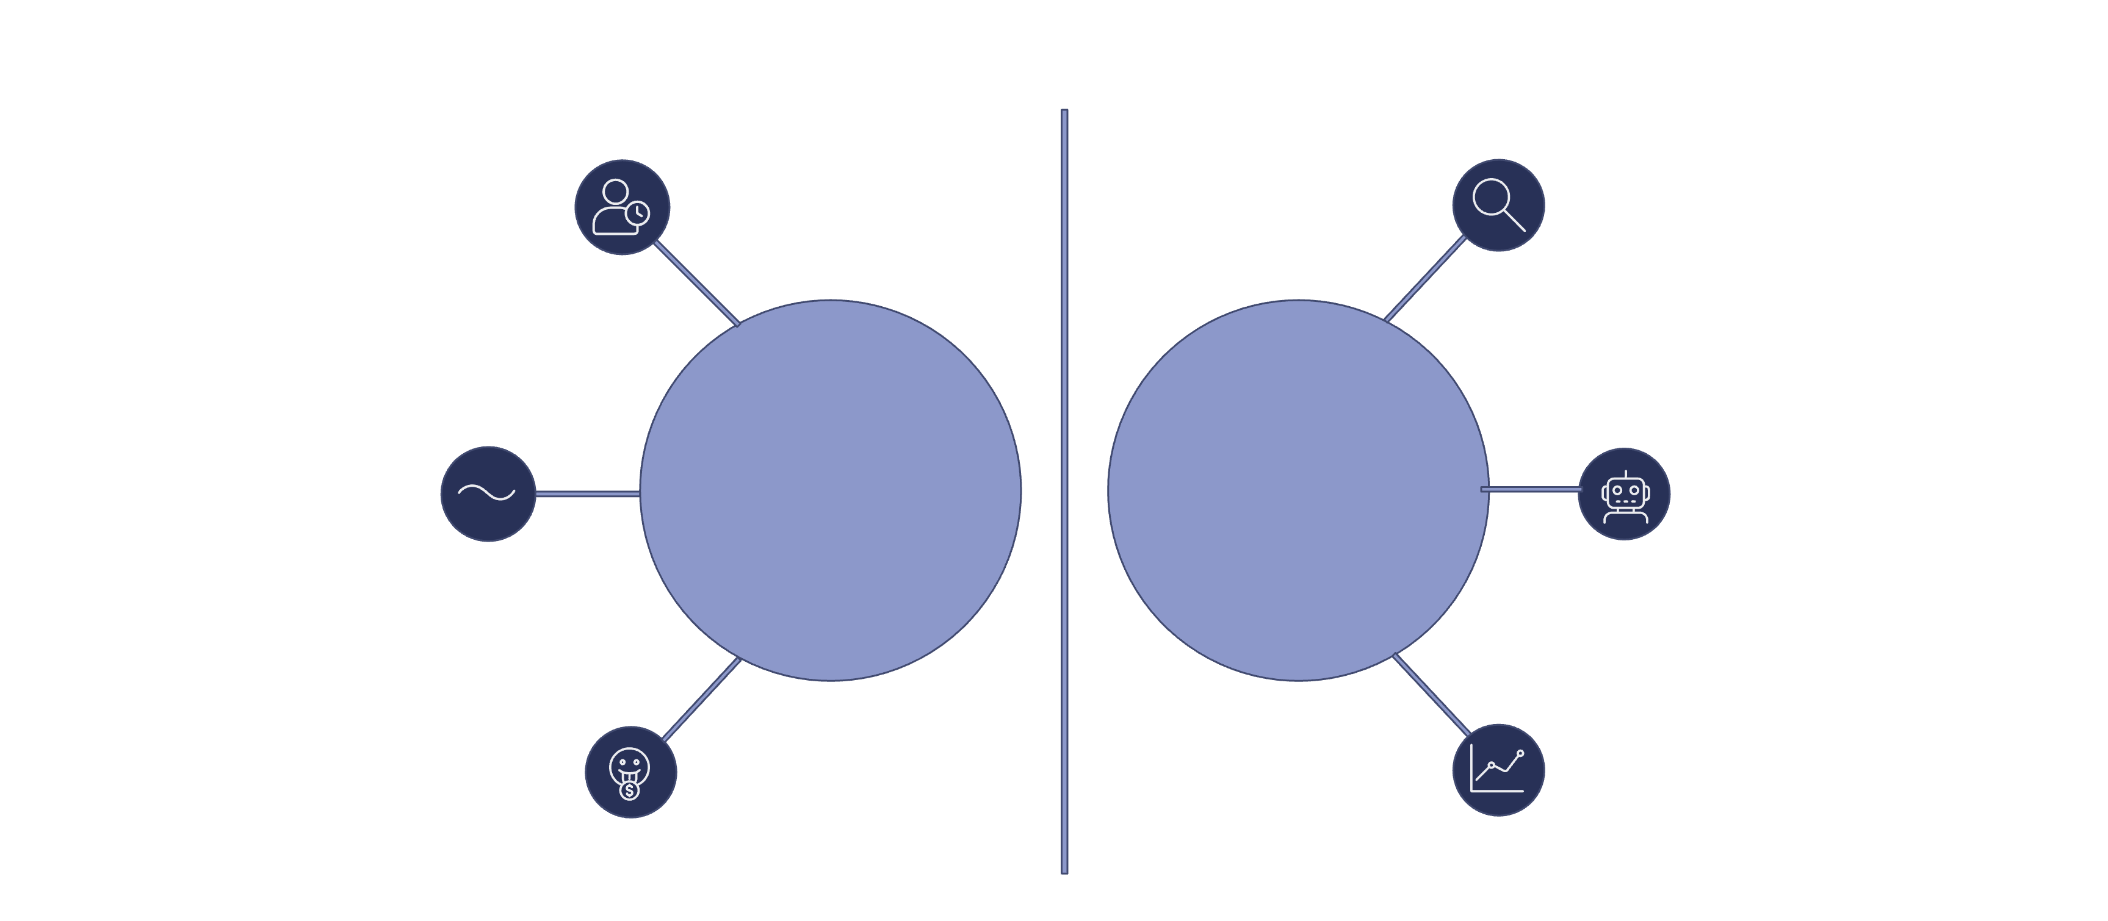





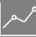
Business Problem & Objective
Manual loan reviews were slow and inconsistent, taking 3-5 days per application with high operational costs.
Slow, inconsistent reviews
Predict high-risk applicants early
3-5 days per application
Manual Processes
Automated Processes
Automate credit decision-making
High operational costs
Balance growth with portfolio quality
Goal: Predict high-risk applicants early and automate credit decision-making to balance growth with portfolio quality.

Slide 3

Data Architecture (SQL Layer)
Our SQL layer integrates crucial loan data from disparate sources, consolidating it into a unified, clean source ready for advanced analytics.
LoanPredictions
Customers
Modelled risk scores
Source: customer profiles
vw_CleanLoans
Repayments
Applications
Payment history details
Loan application records
The vw_CleanLoans view is the unified data source, joining all necessary tables to create a comprehensive and clean dataset, essential for subsequent Python transformations and Power BI visualizations.

Slide 4
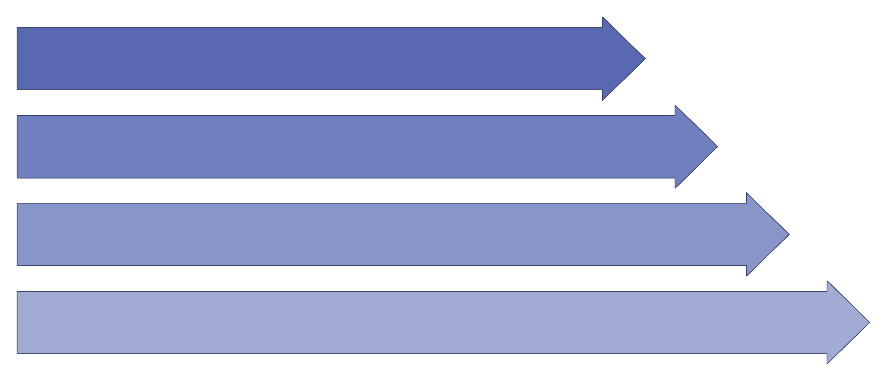
Feature Engineering & Predictive Modeling
Data Extraction
Feature Engineering
Model Training
Prediction & Storage
Random Forest model with 85% accuracy — written back to SQL for BI consumption.

Slide 5

Model Performance
Focus on the key performance metrics that matter to business stakeholders.
85%
82%
78%
0.80
Accuracy
Precision
Recall
F1 Score
Overall correctness of predictions.
Proportion of true positive predictions.
Proportion of actual positives identified.
Harmonic mean of Precision and Recall.
Business Cost Optimization
₹500 per missed default avoided.

Slide 6
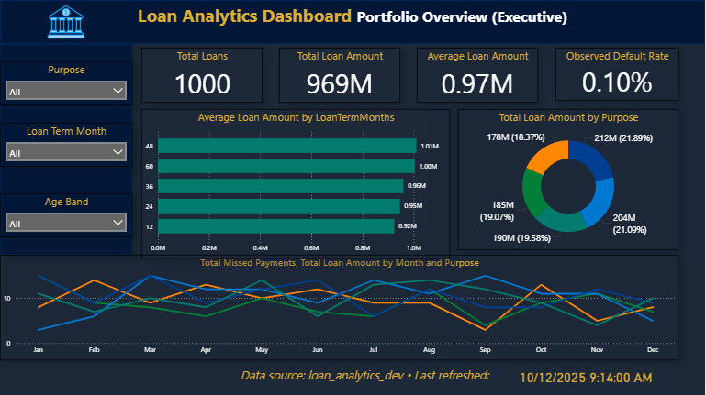

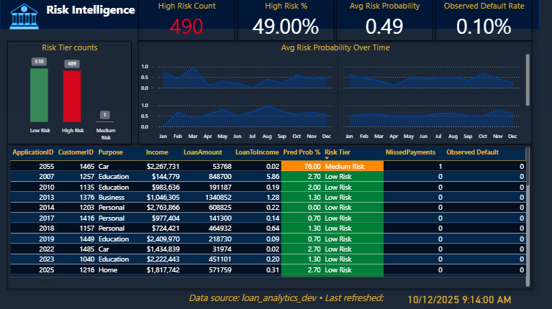


Live Risk Intelligence Dashboard
Connected via DirectQuery for real-time refresh.
Executive KPIs
High-level overview of critical metrics for leadership.
Risk Tier Chart
Interactive visualization of loan risk categories and their distribution.
Repayment Explorer
Detailed analysis of payment history, trends, and delinquencies.

Slide 7
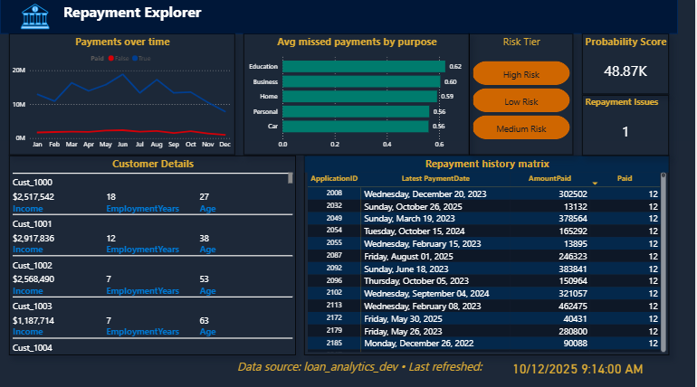
Skills & Tools Demonstrated
SQL
Python
Power BI
Database design
ML model development (scikit-learn)
Interactive dashboards
T-SQL
Data manipulation (pandas)
DirectQuery
Query optimization
Feature engineering
DAX
Transactional data management
Model evaluation
Row-level security

Slide 8





Results & Next Steps
Our automated analytics system has delivered significant improvements and laid the groundwork for future enhancements.
60%
20%
—
Faster Review
Higher Accuracy
Real-time Refresh
Reduced manual processing time significantly.
Improved predictive power of loan risk.
Up-to-date insights for rapid decision-making.
Automation
Improvement
Optimization
Baseline
Future Enhancements
1
2
3
Model Retraining
Explainability Features
Automated Alerts
Continuously update the model with new data for sustained accuracy.
Integrate tools to understand model decisions better.
Set up proactive notifications for high-risk applications.
"Data science that delivers measurable business value."

